Slide 1
Course Recommender System for Online Courses
Presented By:
Ambika K.M. (10)
Anjith Paul (12)
Reenu Thomas (43)
Silpa T.S. (50)

Slide 2
Contents
Introduction
Gantt Chart
Data Collection and Processing
Recommender Model
Recommender Post-Processing
Database Integration
User Interface
User
Admin

Slide 3
Modules
A recommender system is made up of five core components.
Components in a recommender system are ordered in a backend to frontend pipeline.

Slide 4
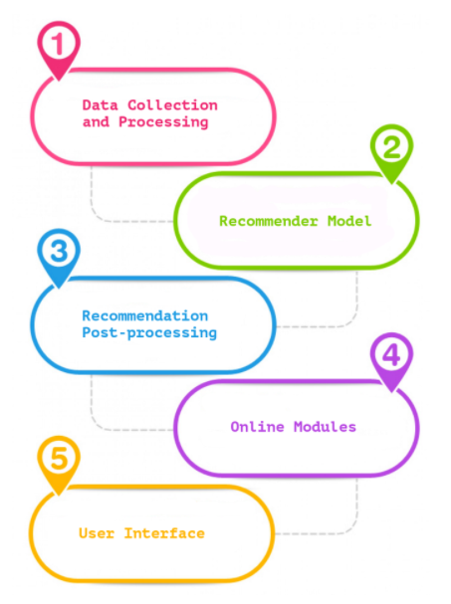
Modules

Slide 5
Data Collection and Processing
Time should be invested in developing the suitable data collection and processing component.
It’s common to have some data cleansing and normalization steps plus some feature generation and selection capabilities.
The quality of recommendations generated is constrained by the quality of the input data.

Slide 6
Recommender Model
This is the core component that generates recommendations for users.
It is responsible for taking data and predicting which items will be of interest to a given set of users.
The inputted data will either be the user’s preferences or descriptions of the items that can be recommended.

Slide 7
Recommendation Post-Processing
The recommendations generated often need some post-processing before being shown to users.
It is common for some recommendations to be filtered out and some re-ranking to be applied.
Post-processing can be done in batch mode, real-time mode or as a combination of the two modes.

Slide 8
Online Modules
These are responsible for serving the recommendations and tracking their use.
It is here where, what needs to be stored in your logs is defined in order to both report how the system is performing and to also learn from its usage and interactions.
This can be used to perform any online testing (e.g. A/B testing) of different methods for generating recommendations.

Slide 9
User Interface
This module defines what users see and how they can interact with the recommender.
The interface has a big impact on the usefulness of a recommender system.
It is a good practice to explain to users why they are being recommended an item.

Slide 10
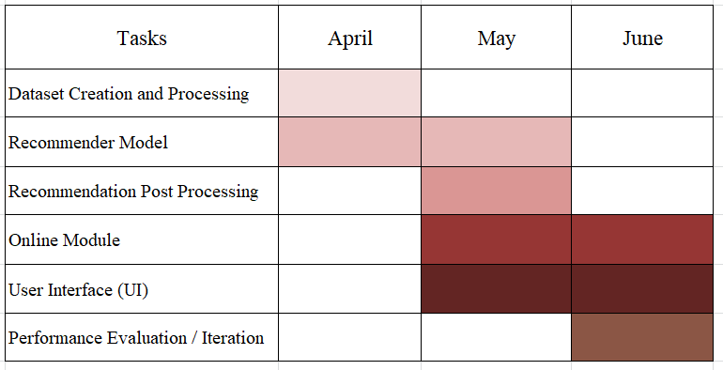
Gantt Chart
Depending on these five components required for the development of our system we have charted the Gantt Chart as follows:

Slide 11
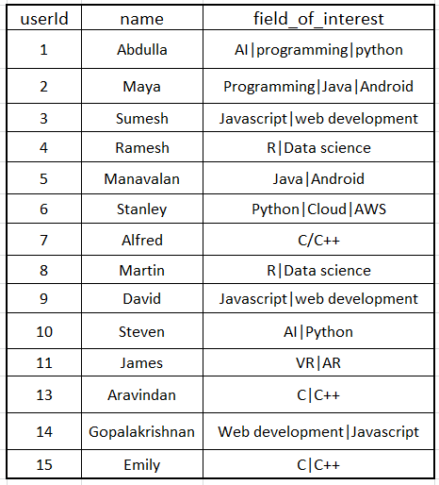
Module 1 – Dataset Creation and Processing
Dataset used to store the user details which is used for content-based filtering.

Slide 12
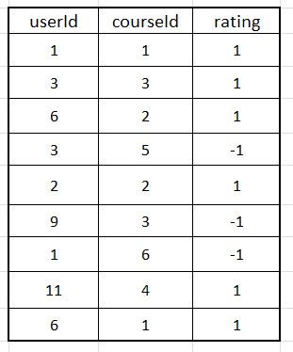
Dataset used to store the rating of courses for different users.
Courses liked by the user are represented by 1 and the courses disliked by the user are represented by -1. This table is used for implementing collaborative filtering.

Slide 13
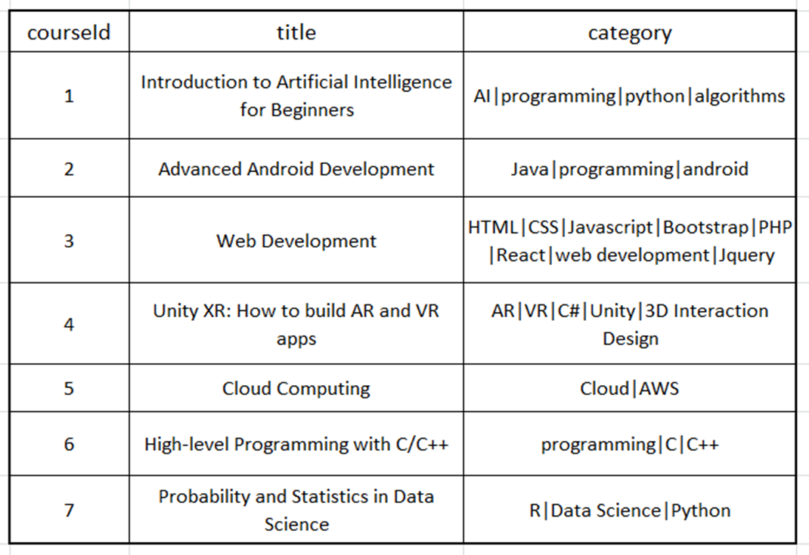
Dataset containing the course details used in both the filtering algorithms.

Slide 14
Data Importing and Cleaning
We use Pandas library for data manipulation and analysis.
Pandas makes it easier to read and clean the tables.

Slide 15
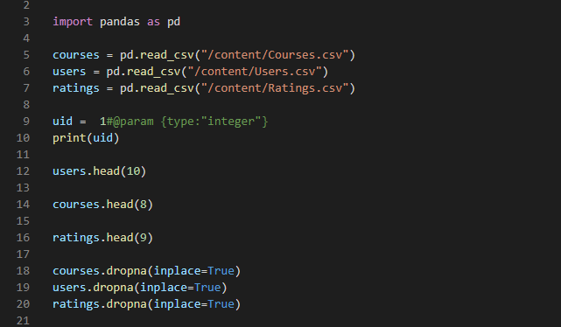
Data Importing and Cleaning

Slide 16
Module 2 – Recommendation Module
Recommendation Module is where the actual recommendation happens.
Recommendation Module takes the userID as input, and produces the recommendation based on the course, user, and rating data available on the database.
The Recommendation algorithm is a hybrid of Content Based and Collaborative Filtering methods.

Slide 17
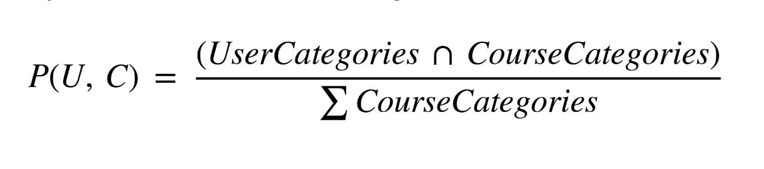
Content Based Algorithm
Content Based Recommendation algorithms are aware of the content of the product.
In this case the contents are the topics covered in each course and the interested topics of each user.
These contents are available in the Course table and the User table respectively.
The algorithm use these data to produce accurate recommendation.

Slide 18
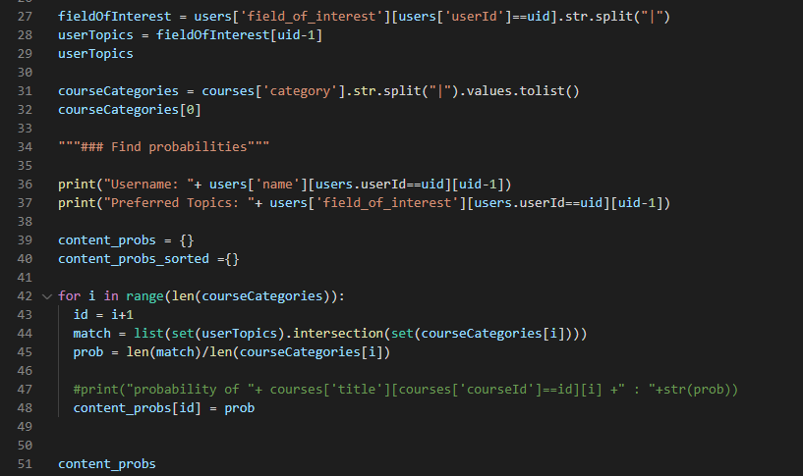
Content Based

Slide 19
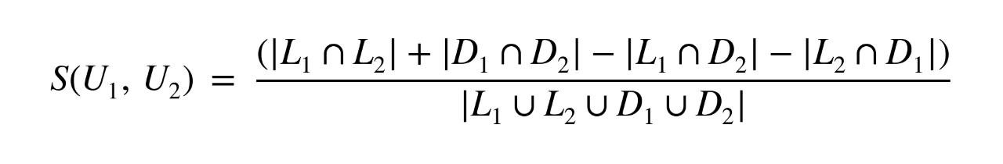
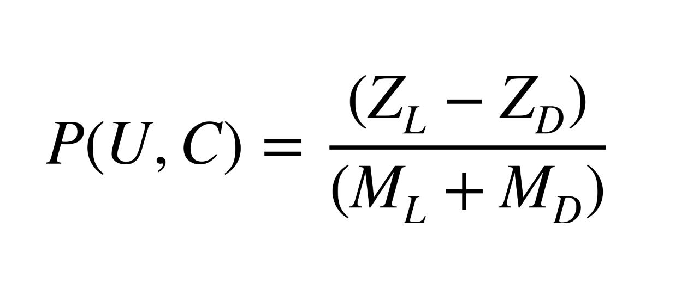
Collaborative Filtering Algorithm
Collaborative Filtering is used to get accurate prediction of subjective data.
Collaborative filtering first finds the similarity with other users.
Users who like same courses and dislike same courses are more similar to each other.
Then use this similarity to find the courses that the user will like the most.

Slide 20
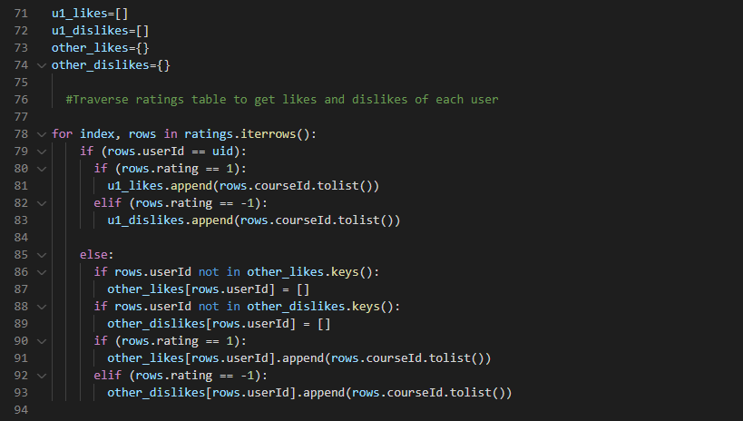
Collaborative Filtering

Slide 21
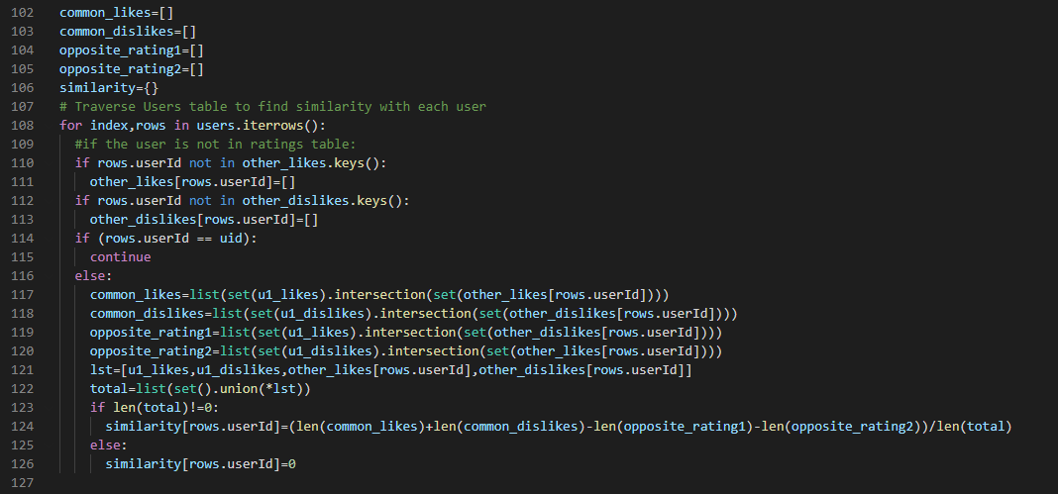
Finding User Similarity

Slide 22
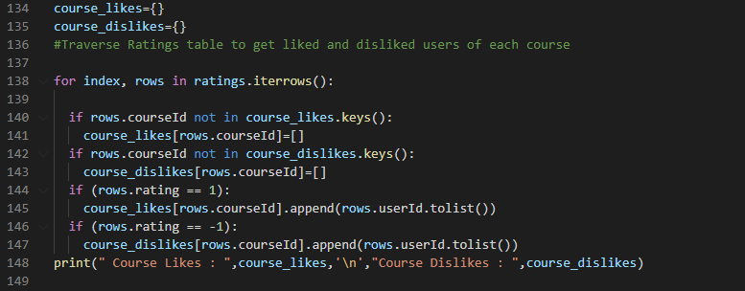

Slide 23
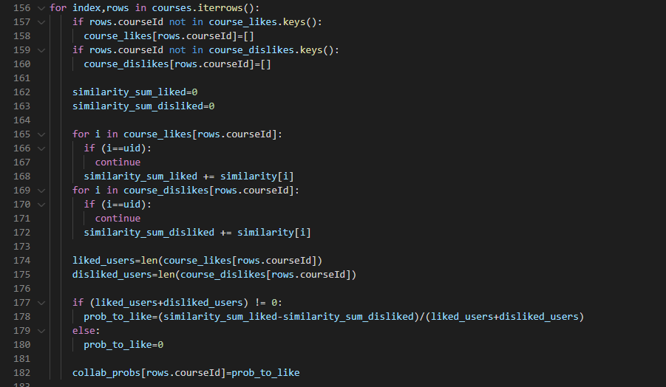

Slide 24
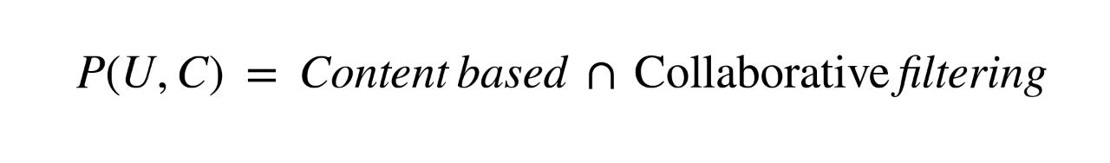
Hybrid Algorithm
Both Content Based and Collaborative Filtering algorithms have their own strengths and weaknesses.
Content based method is better when the user is new and don’t have enough data to find similarity, and when a course with less ratings would be a better choice for the user.
Collaborative filtering provides a subjective approach by making the prediction based on user interactions rather than on data given by the user.
We can get the best of both worlds by combining these two algorithms.

Slide 25
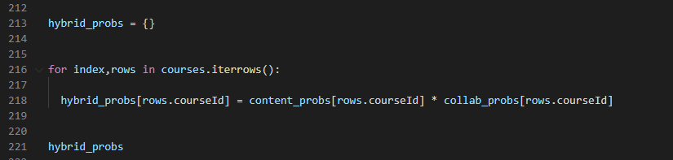
Hybrid

Slide 26
Module 3 – Recommendation Post Processing
In post processing, the recommendations of courses with very low probabilities to be liked by user are removed.
Sometimes the user may want to get more recommendations than on hybrid results.
In that case instead of not providing anymore courses or recommending random courses, we take the results of content based and collaborative filtering individually.
If a user has not rated any other course, we can’t get user similarity and hence recommendations are based on Content Based method only.

Slide 27
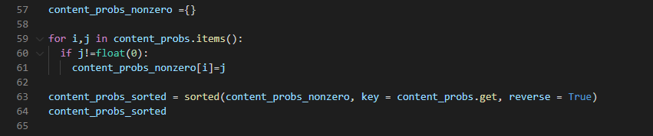
Content Based: post processing

Slide 28
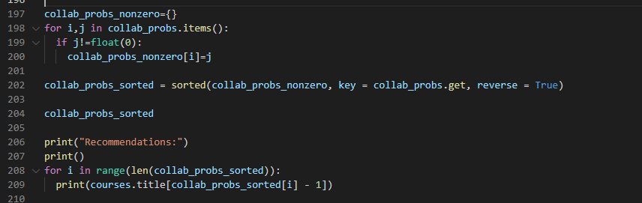
Collaborative: post processing

Slide 29
Hybrid: post processing

Slide 30
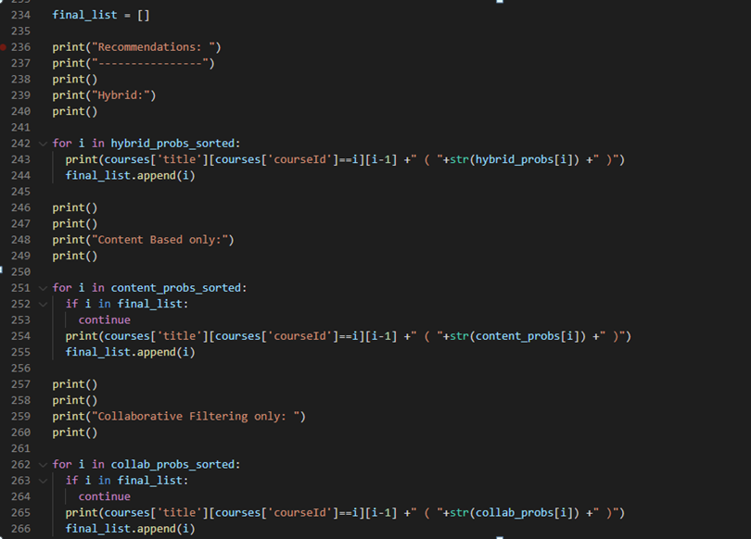
Final post processing

Slide 31
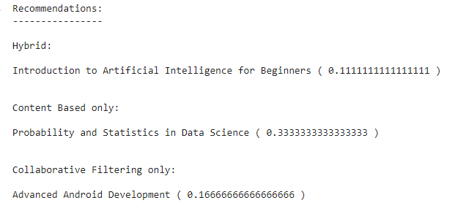
Output for user ID = 1

Slide 32
Module 4 – Online module
In online module, we take the recommendation algorithm and host it online.
We are using django framework for the online implementation of the Course Recommendation System.

Slide 33
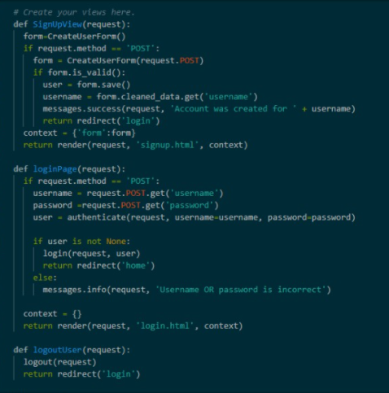
Code for User Authentication View

Slide 34
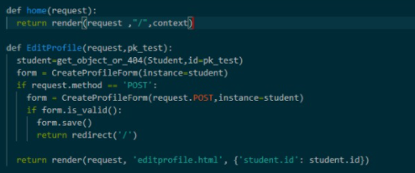
Home Page and Edit Profile View

Slide 35
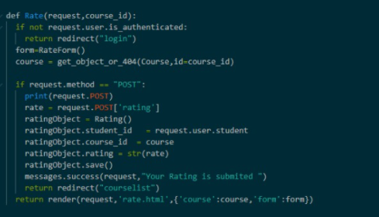
Code for Course Rating View

Slide 36
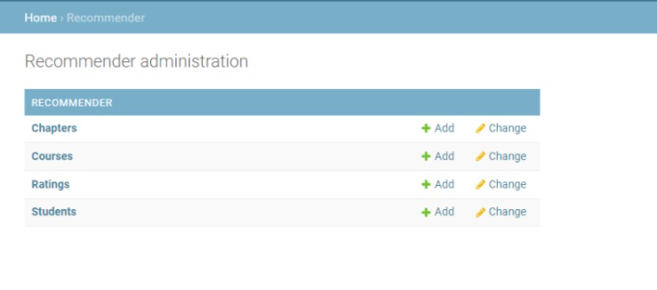
database

Slide 37
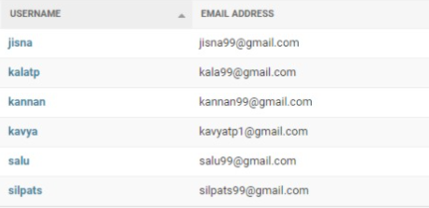
Database - User

Slide 38
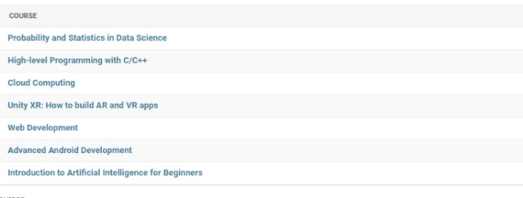
Database – Courses

Slide 39
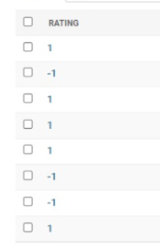
Database – Rating

Slide 40
Module 5 – User Interface
This module defines what users see and how they can interact with the recommender.
The interface has a big impact on the usefulness of a recommender system.

Slide 41
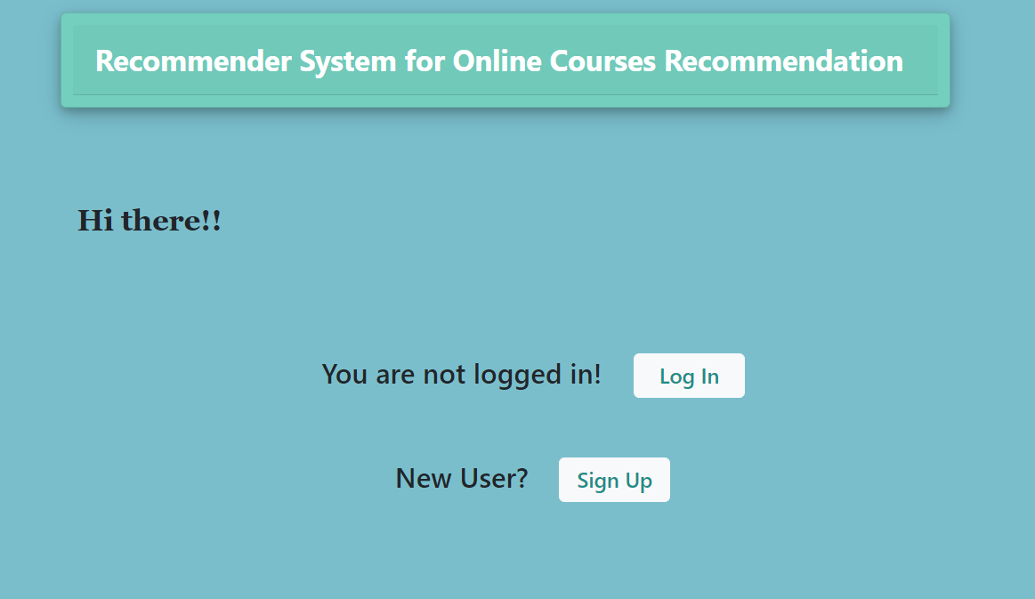
UI – Home Page

Slide 42
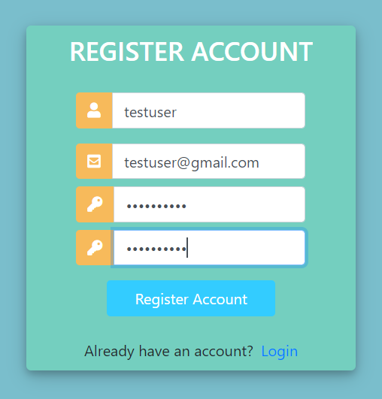
UI - Registration

Slide 43
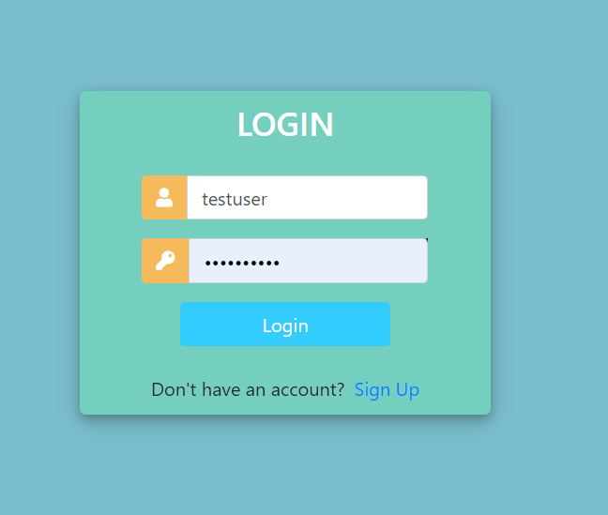
UI - Login

Slide 44
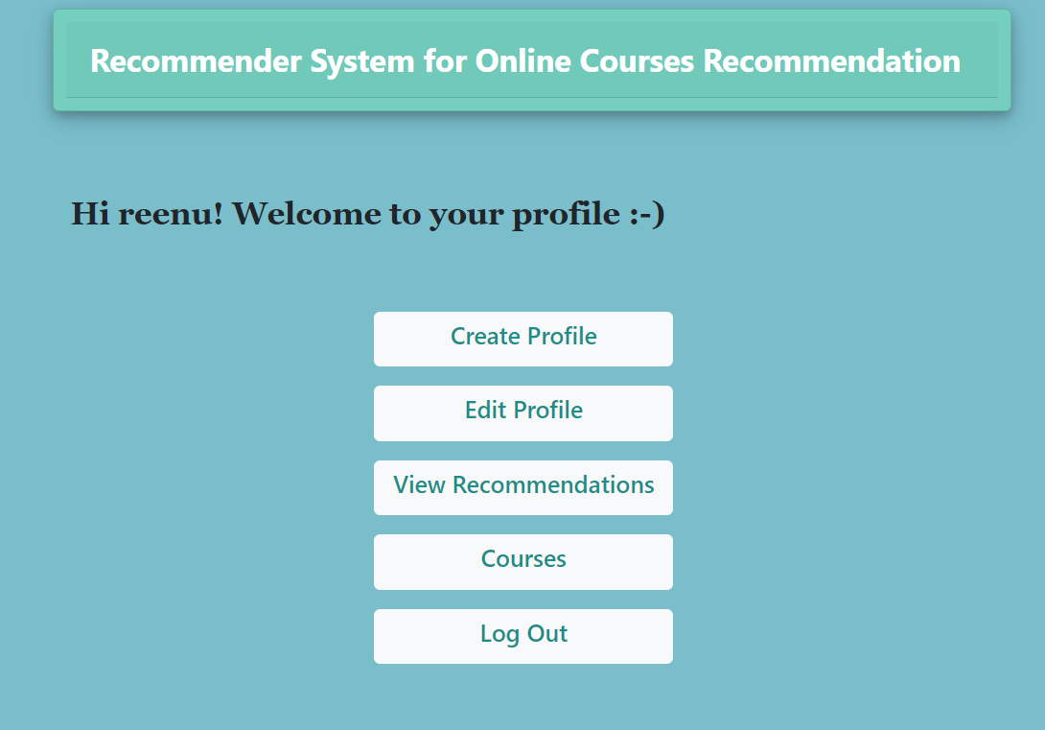
UI – User Home Page

Slide 45
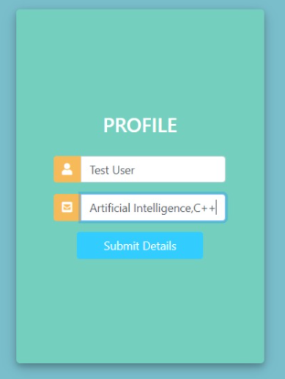
UI – Create Profile

Slide 46
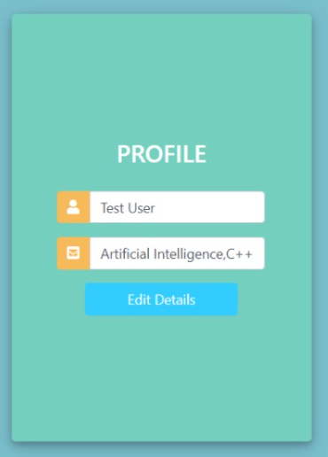
UI – Edit Profile

Slide 47
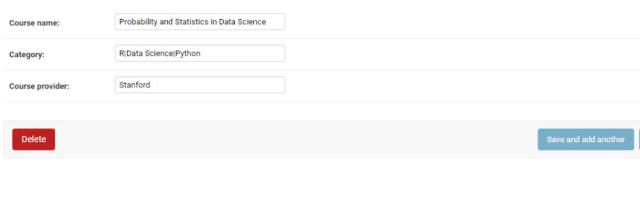
Admin - Course

Slide 48
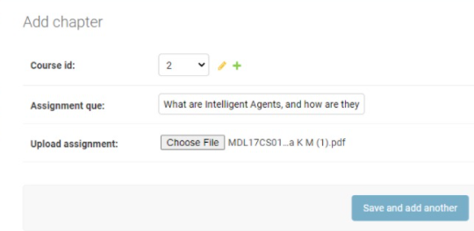
Admin - Chapters

Slide 49
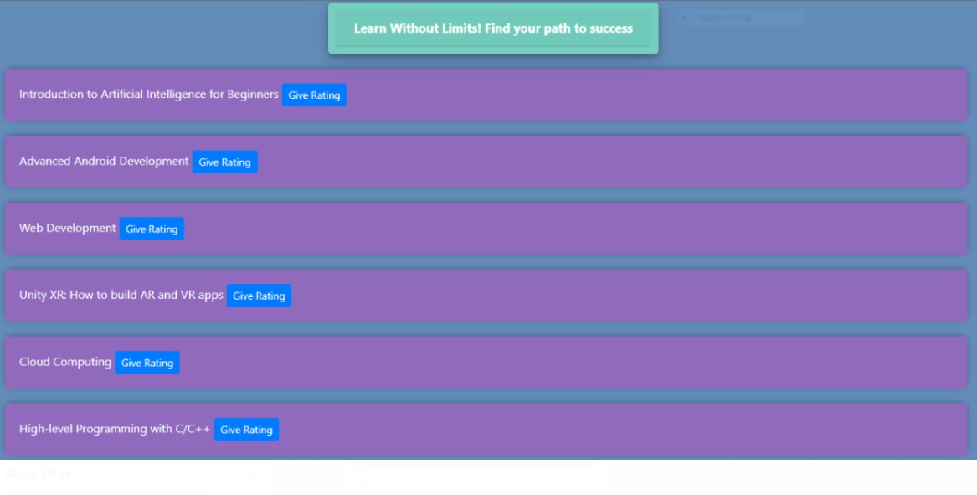
UI – Courses

Slide 50
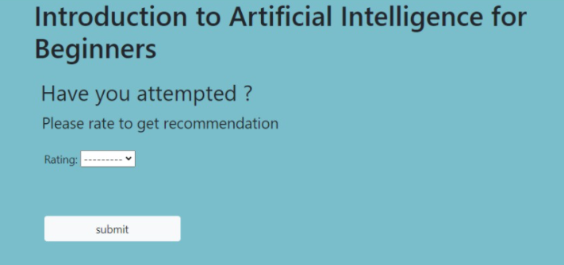
UI – Rating

Slide 51


